Slide 1
Object Oriented Programming week 2 26–30 aug, 2019
Instructor:
Abdul Aziz
Assistant Professor
(Computer Science Department)
National University- FAST (KHI Campus)

Slide 2
acknowledgment
- Publish material by Virtual University of Pakistan.
- Publish material by Deitel & Deitel.
- Publish material by Robert Lafore.

Slide 3
Object
Technical Definition:
- “An Object is an Instance of a class”
- “An Object is the implementation of a class”
In general we say :
“ Any tangible thing for which we want to save Information”
Now onwards we treat object technically.

Slide 4
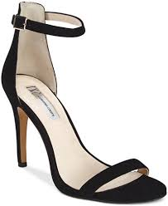
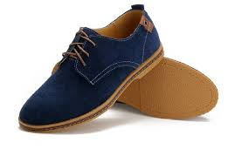
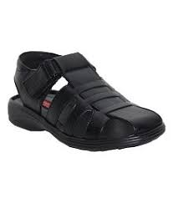
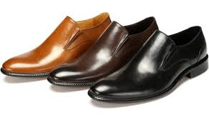
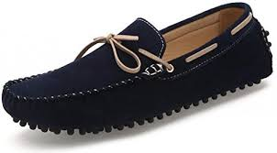
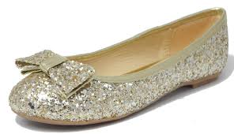
Some Examples
SHOES
Female sandal
Casuals
Men sandal
Formal
Loafers
Pumpies

Slide 5





Humans

Slide 6


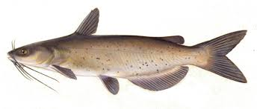

FISH

Slide 7
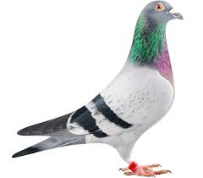
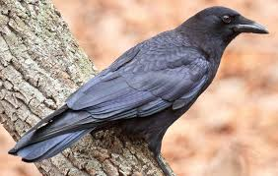

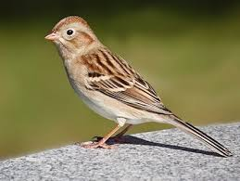
BIRD

Slide 8



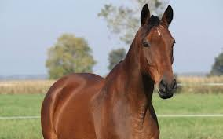
Animal

Slide 9
Discussion
- Object belongs to a group.
- Which similar.
- Have some common attributes.
- Have some common behaviors.
- We can categorized objects on some basic features …. ?

Slide 10
Class
- Collection of Similar object.
- The objects that share some common features.
- It is the a design of an object.
- It is a detail of an object.
- It tell us what an object contains in it.
Technical Definition:
“ A class is blueprint of an object”

Slide 11
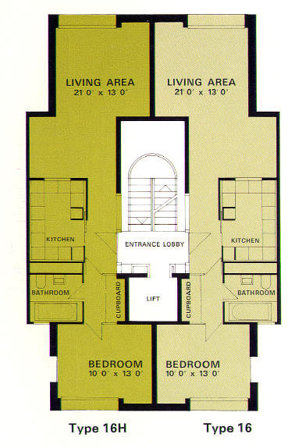
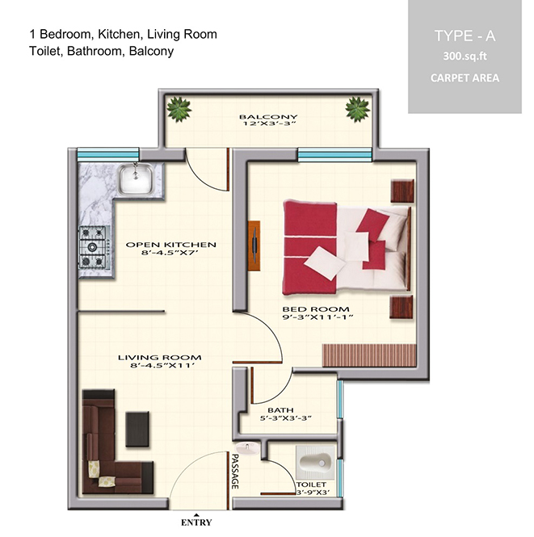

Slide 12
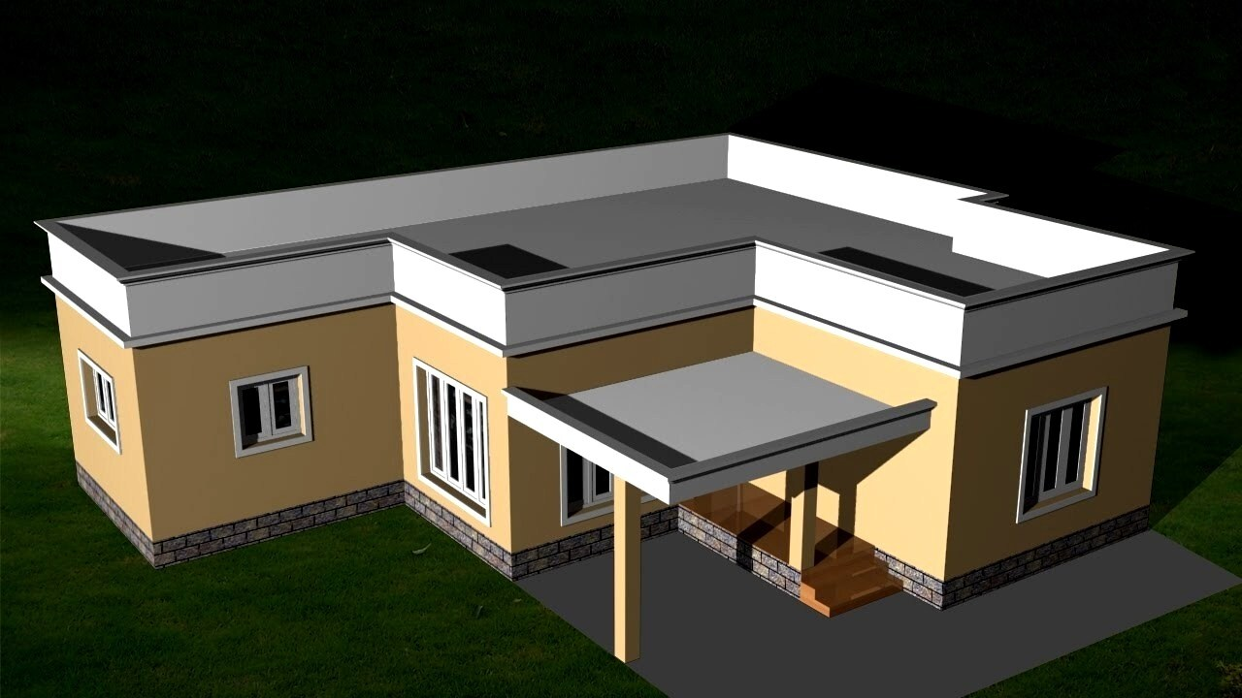
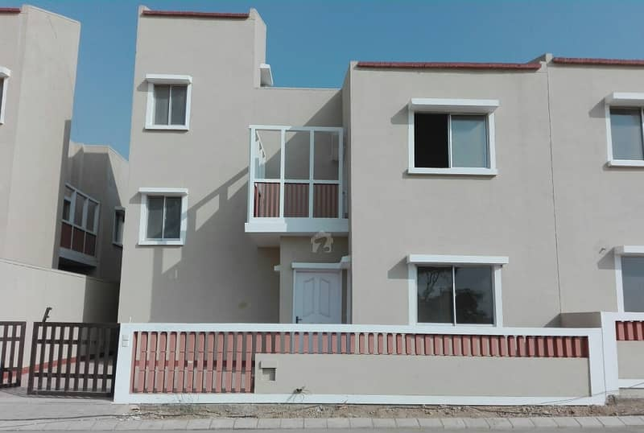

Slide 13
Summarize
A class :
It’s a blue print .
It’s a design or template.
An Object:
Its an instance of a class.
Implementation of a class.
NOTE: Classes are invisible, object are visible

Slide 14
Generalized Class
- The class that only exhibits the common features of its objects.
Examples:
- ANIMAL
- BIRDS
- HUMAN
- No object of generalized class is found.

Slide 15
Specialized Class
- The class that exhibits different or unique features (behaviors)
ANIMAL (Generalized)
Specialized:
Mammals
Cats
Dog
ANIMAL
WILD PET
CAT CAT
Lion Streat Cat Persian Siamese

Slide 16
Type of classes
1- Abstract Class: The classes we make against abstract concepts are called abstract classes. Abstract Classes can not exist standalone.
2- Concrete Class: The entities that actually we see in our real world are called concrete objects and classes made against these objects are called concrete classes.
3- Sub-type: Sub-typing means that derived class is behaviorally compatible with the base class. Also known as Extension.
4- Specialized class: Specialization means that derived class is behaviorally incompatible with the base class

Slide 17
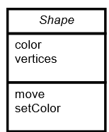
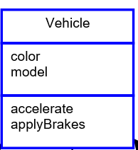
Abstract Class

Slide 18
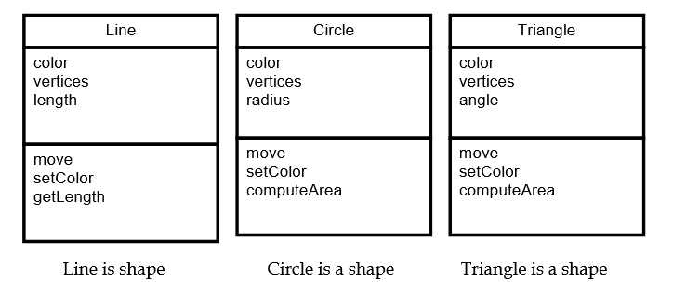
Concrete Class

Slide 19


Class Activity
5- Pen
3- Parents
4- Playground
2- Classroom
0/1- Library
6- Book
7- Bag
8- Student
9 Teacher

Slide 20
Questions
1- Identify at least 3 behaviors and related data for an object.
2- Draw an object interaction model based on the objects .

Slide 21
Solution
Teaches
Student
Plays-in
Playground
Teacher
Has
Book
Pen
School Bag

